Slide 1
Energy Transition Preparedness Initiative
Learnings from Electricity Sector Study
Date : 16th April 2024

Slide 2
Electricity Themes
Eleven indicators, 55 attributes, 141 sub-attributes – Over 1500 data points from states
Data for ten states used available on website : etpi.in
2

Slide 3
Outline
Findings
Key trends from the states
Good practices that can be replicated
Areas that require attention going forward
Lessons and Insights
Broad observations based on the study
Study covered the following ten states
Bihar | Delhi | Gujarat | Karnataka | Kerala
Madhya Pradesh | Maharashtra | Rajasthan | Tamil Nadu | Uttar Pradesh

Slide 4
Major policy changes in recent years
Planning and Investments
Resource Adequacy (Rules, Guidelines, Regulations)
Financial viability and economic optimisation of the power sector value chain
Late Payment Surcharge Rules → strict penal provisions for non-compliance
Enabling provisions regarding ToD tariff design in Rights of Consumer Rules
Enabling provisions for recovery of revenue via fuel surcharge
Additional prudential norms for borrowing
Provision of reliable, affordable competitive power supply to consumers
Green Open Access Rules and adoption by SERCs
Suryoday/Surya Ghar Yojana providing capex grants for RTPV installations
Enabling provisions for net metering, group net metering
Shift of agricultural demand to day time in multiple states and at the national level
Renewable Energy Purchase and Storage Purchase Obligations
Rollout of RDSS scheme → smart metering, network investments
4

Slide 5
Findings
Capacity Addition and Power Procurement
Compliance with renewable energy obligations
Energy Storage capacity addition trends
Status of Coal capacity in the pipeline
Consumer Choice and direct procurement options
Implementation of Green Energy Open Access
Factors affecting Open Access and Captive savings
Distribution company finances
Cumulative and annual losses of Distribution Companies
Dependance on government subsidies and cross subsidies
Time of day tariffs
Key trends
Quality of Supply and Service
DT failure rate trends

Slide 6
Capacity Addition and Power Procurement
Compliance with renewable energy obligations
Energy Storage capacity addition trends
Status of Coal capacity in the pipeline

Slide 7
Key Trends: Renewable Purchase Obligation (RPO) Targets
National Framework under Electricity Act: July 2022 Order by Ministry of Power (MoP):
Total RPO target → 43% of total consumption by 2030 | Specific targets for new wind , hydro.
State Level Targets post 2022 in ten states
6 of 10 states have notified RPO regulations in line with this Order
Bihar, Maharashtra, Rajasthan, Tamil Nadu have adopted 43% target
Madhya Pradesh target lower at 38% and Kerala higher at 50%
National Framework under Energy Conservation (EC) Act : October 2023 MoP notification, effective from April ‘24:
Different annual RPO but cumulative of 43% by 2030 | DRE target (projects <10 MW) → 4.5% by 2030
Penalties as per EC Act: >Rs. 10 lakhs/failure
Additional Penalty → >2x price of every MTOE due to failure (about Rs.3/unit)
Revision in state frameworks since 2023 in ten states
Maharashtra revised targets since 2023 notification
Separate targets for DRE
Other states yet to amend regulations to give effect to revised annual targets and provide clarity on penalties

Slide 8
Key Trends: RPO Compliance across ten states
Regularity with which RPO compliance is assessed
Only Karnataka and Bihar have compliance orders for FY2022 -23
5 of ten states have issued compliance orders since 2019-20
Tamil Nadu and Kerala have not issued any RPO compliance orders till date
Action taken in case of non-compliance
Karnataka has complied with RPO targets
No state has imposed penalties for RPO non-compliance since 2020-21.
MERC allowed for carry forward in FY22. Carry-forward has been discontinued as per latest regulations
For more details on RPO regulations, targets and compliance from 2010 to 2022 please see: indiaredata.org
8

Slide 9
Key Trends: Storage Procurement
Energy Storage Obligation (ESO) specified in July 2022 → energy storage at 4% of consumption
Can be met using PSPs/ Battery Energy Storage Systems
7 of 10 states have notified ESOs till FY 2029-30 | Kerala SPO @ 2% by 2030
Battery Energy Storage Systems (BESS) Tenders
Investments in Pumped Storage Projects

Slide 10
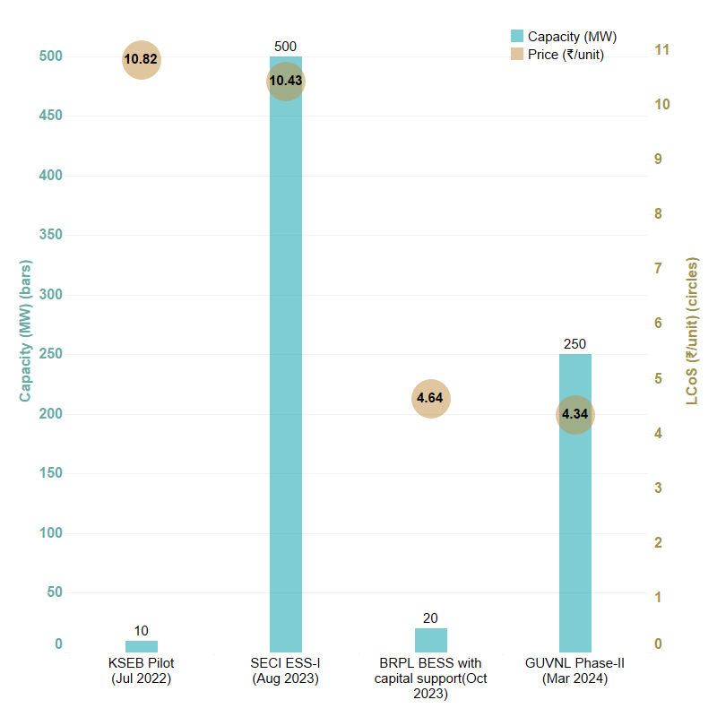
Battery Energy Storage Systems (BESS)
Increase in volume of tenders | Record low prices
Standalone (Tenders awarded): 2 hour requirement
RE + BESS
CEA: BESS capacity required for 2029-30: 41650 MW/208250 MWh
Tenders awarded:
7 tenders awarded for total capacity of 6698 MW.
6 Open tenders:
FDRE →1860 MW + 600 MW green-shoe
Solar + ESS →1890 MW (4 Tenders)
Firm and Dispatchable RE (FDRE)
4 FDRE Tenders awarded for 4648 MW
Requirement→ 95% of Peak to 90% of all hours
Demand fulfilment ratio of 90% in 2024 SECI Tender
480 MW @ Rs. 5.6/unit
Awarded for Madhya Pradesh and Punjab DISCOMs requirement
Open tenders :
GRIDCO: 500 MW/2500 MWh
GUVNL: 250 MW/500 MWh,
10

Slide 11
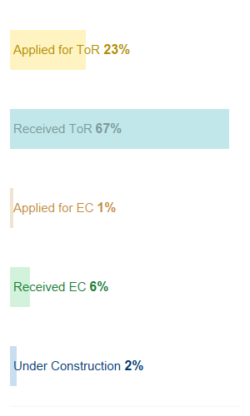
Key Trends: Investments in Pumped Storage Projects (PSPs)
Early activity and investor interest
Policy Framework and targets
18.98 GW/ 128.15 GWh of PSP required to meet storage requirement by 2030 (CEA)
Several MoUs being signed for investments in states
PSP Policies in 3 states: Andhra Pradesh | Maharashtra* | Uttarakhand
DISCOMs as well as C&I consumers have evinced interest in procurement
PSPs in Environment Clearance (EC) and construction pipeline
Capacity in various stages of obtaining EC → 143 GW across 115 projects
Capacity which received environmental clearance: 8% (11.5 GW)
Capacity under construction: 2% (2.35 GW)
Status of 11.5 GW with EC
78% of this capacity in Uttar Pradesh, Andhra Pradesh, Karnataka and Madhya Pradesh
65% capacity being developed by private players, 26% by state
* ToR= Terms of Reference
*The policy has been cabinet approved but not in the public domain.

Slide 12
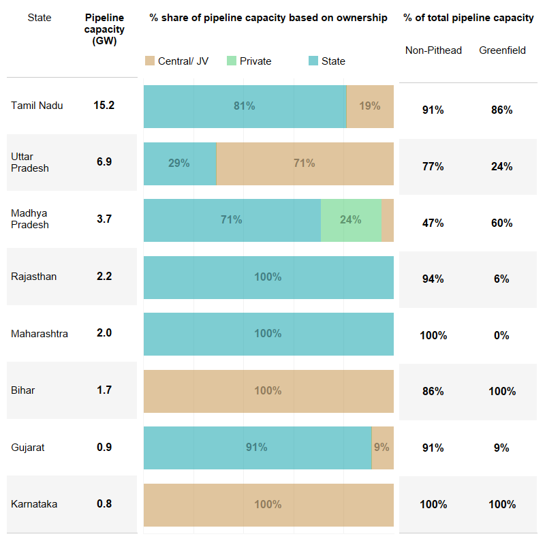
Key Trends: Pipeline Coal Power capacity for DISCOMs
Diverse and Evolving based on state requirements
Wide variation in pipeline capacity in ten states
4 states account for 84% of the pipeline
Rajasthan: None in construction stage
Tamil Nadu: Only 30% of 15 GW under construction
Uttar Pradesh: 40% in the pipeline for over 8 years
Madhya Pradesh: Contracted mostly in 2019
Pipeline capacity type in ten states
Capacity mostly state-owned in 5 of 8 states
84% is non-pithead and 59% is greenfield.
Maharashtra, Rajasthan, Gujarat ➔ highest share
of brownfield
Only projects which received board approval are considered for the pipeline.
JV refers to joint venture between central and state agencies .

Slide 13
Consumer Choice and Direct Procurement Options
Implementation of Green Energy Open Access
Factors affecting Open Access and Captive savings

Slide 14
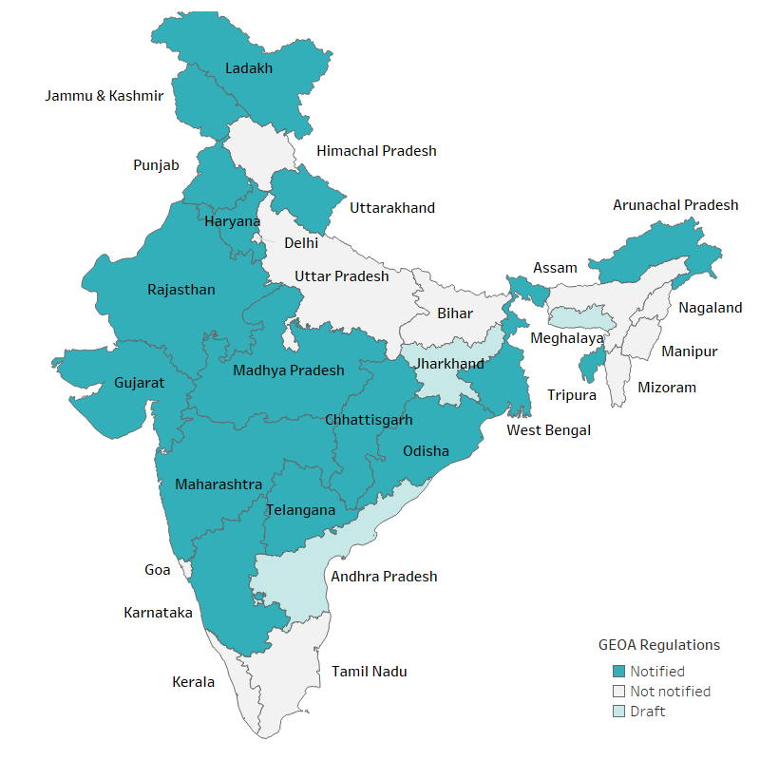
Green Energy Open Access (GEOA) rules and adoption by states
Game changing framework for competition, RE deployment- rapid adoption in states
GEOA Rules notified by MoP – Major provisions
Minimum Eligibility – Load > 100 kW for OA, no load limit for Captive.
Aggregation through multiple connections.
Centralised portal for processing GEOA applications
Standardised frameworks for application, scheduling, banking etc.
OA charges– As per methodology by Forum of Regulators
50% concession on Additional surcharge, long-term ceiling on Cross Subsidy Surcharge
Adoption of GEOA provisions by State ERCs
15 states notified regulations, 3 states draft stage
5 of 10 studied states notified the GEOA regulations – Gujarat, Karnataka, Madhya Pradesh, Maharashtra and Rajasthan.

Slide 15
Adoption of GEOA provisions by State ERCs
Frameworks evolving on crucial issues based on state realities, implementation challenges
Variations in provisions
Banking applicability
Banking – Duration,
Charges
Standby charges
Concessions on
OA charges
Metering
Provisions universally adopted
100 kW minimum eligibility
No load limit on captive
Nodal Agency: STU for LTOA and MTOA; SLDC for STOA
Definition of “green energy”
Centralised processing of applications
Notes:
Can we make this slide better?

Slide 16
Consumer choice: Potential savings from green open access
Facilitative frameworks and standardised charges help avail competitive choice.
However, savings from green energy open access (RE based third party sale and captive investments) depend on the following:
Cost of power
Access to low cost finance
Changes in DISCOM tariff
Levy of Day time ToD rebates
Long term commitment (> 10 years) to reap benefits, especially for cash-constrained small and medium sized C&I consumers
Shorter durations → Higher the cost of power
15 to 20% rebate in energy charge during 8 solar hours could erode away savings for many consumers
Transaction costs
Access to markets, aggregators
Aggregation can help reduce the cost of power, risk for smaller consumers
Transaction cost might be high initially till viable models evolve at scale

Slide 17
Savings for Open Access (OA) in FY24
OA vis-à-vis DISCOM charges for HT Industrial (33kV) consumer :
Scenario 1: Cost of procuring RE power at 3.5 Rs/unit
Scenario 1: Cost of procuring RE power at 4 Rs/unit
Scenario 1: Cost of procuring RE power at 4.5 Rs/unit
Savings are the lowest in Odisha and highest in UP
Savings across scenarios:
Rs 3.5/u → (-) in 5 states | > 10% in 5 states
Rs 4.0/u → (-) in 7 states | > 10% in 2 states
Rs 4.5/u → (-) in 13 states | > 10% in 0 states

Slide 18
Savings for Captive in FY24
Savings for Captive vis-à-vis a DISCOM HT Industrial (33kV) consumer at following scenarios:
Scenario 1: Cost of procuring RE power at 3.5 Rs/unit
Scenario 1: Cost of procuring RE power at 4 Rs/unit
Scenario 1: Cost of procuring RE power at 4.5 Rs/unit
Savings lowest in Odisha, highest in Karnataka & Punjab.
Savings across scenarios (except Odisha)
Rs. 3.5/u → < 20% in 0 states | > 30% in 11 states
Rs. 4.0/u → < 20% in 2 states | > 30% in 6 states
Rs. 4.5/u → < 20% in 6 states | > 30% in 3 states

Slide 19
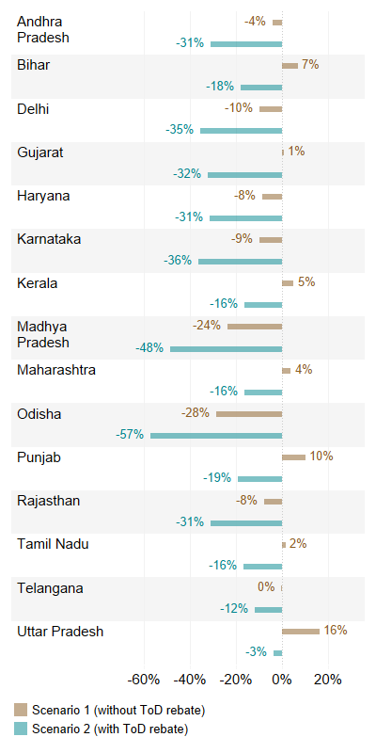
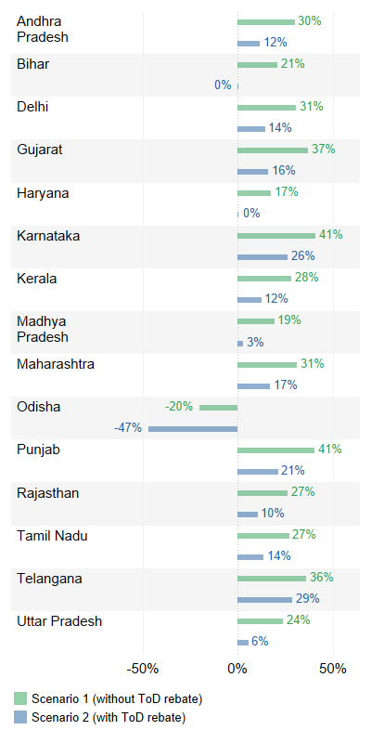
Savings for Open Access and Captive in FY24 with discounted day time tariffs
As per the Electricity (Rights of Consumers) Rules – Power tariff to be 20% less during solar hours.
Here, cost of procuring RE is assumed to be Rs 4/unit.
ToD rebate is 20% of the tariff applicable for that category
Impact of solar hours rebate on OA savings
Impact of solar hours rebate on Captive savings
Notes:
Captive : Non ToD → < 20% in 2 states | > 30% in 6 states ….ToD < 20% in 11 states | > 30% in 6 states (Haryana, Bihar, MP, UP)
OA: : Non ToD → (-) in 7 states | > 10% in 2 states….ToD (-) in all 15 states| > -30% in 8 states

Slide 20
Distribution Company Finances
Cumulative and annual losses of Distribution Companies
Dependance on government subsidies and cross subsidies
Time of day tariffs

Slide 21
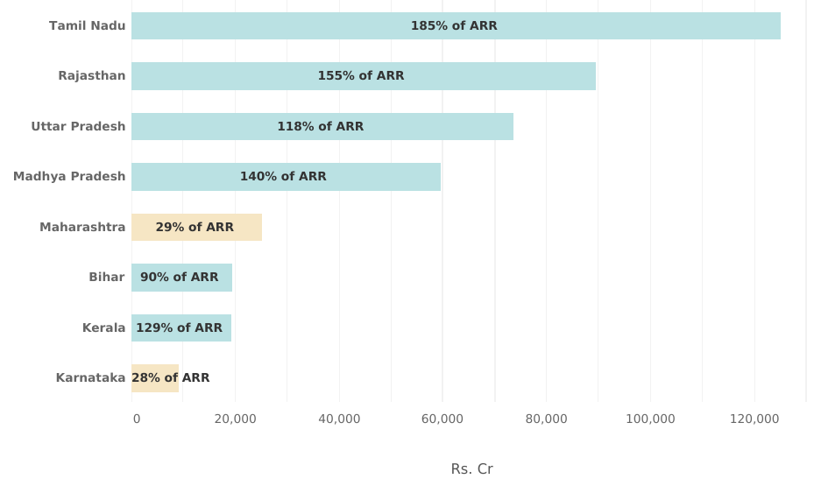
Cumulative losses of state DISCOMs
Steady increase in past losses since UDAY, concentrated in few states
Cumulative losses till FY22
Rising nationally till FY22
All India Losses at Rs. 5.74 lakh Cr. by March 2022
11% increase since 2020-21
Average growth for past 7 years has been 7%
Bulk of the losses in few large states
5 states account for 62% of the national losses
Tamil Nadu, Rajasthan, Uttar Pradesh, Madhya Pradesh and Maharashtra
In 6 states, losses are ≥ 90% of revenue requirement
Gujarat and Delhi reported cumulative revenue surplus for FY22
Accumulated and annual losses, working capital borrowing, dependance on subsidy and payment discipline of the government are important and interconnected signs of financial stress before discoms.
To get a complete picture it is necessary to track all these parameters.
21

Slide 22
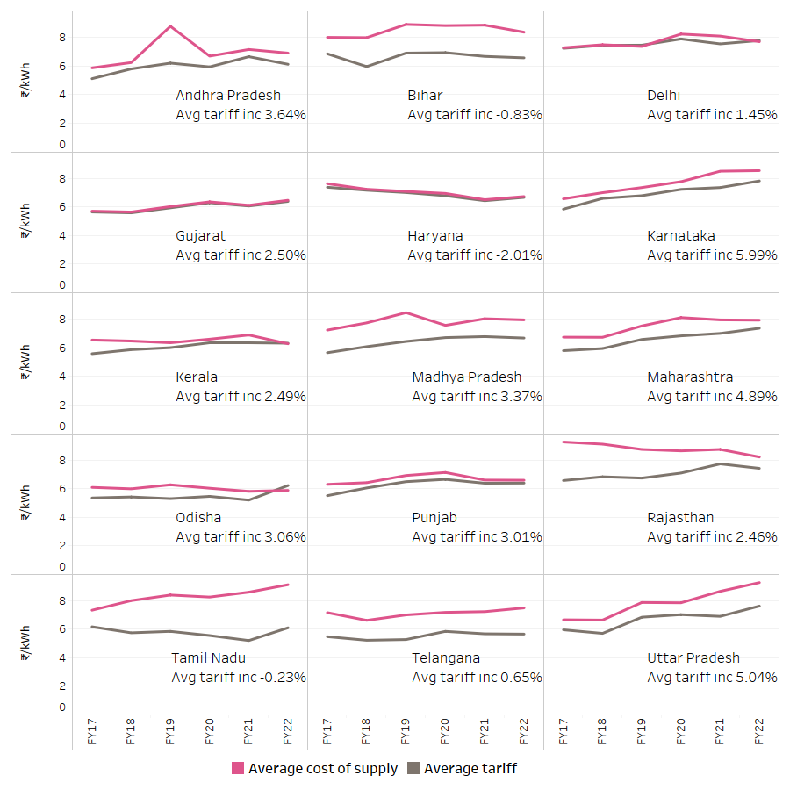
Annual losses of State DISCOMs
Reduction of losses in states due to tariff increase, loss take-over
FY17- FY22: Cost of supply and tariff across 15 states
Annual losses over 6 years in 15 states
Wide, persistent gap between cost and tariffs in 4 states
Gap reducing over time in 4 states
Haryana, Gujarat and more recently in Delhi Kerala and Punjab have hardly any gap
Tariff increase is lower than inflation in 12 of 15 states
Annual loss take-over by state governments
Post UDAY: State Government take-over of annual losses as grant/ subsidy as part of FRBM schemes, RDSS
Take-over trends :
FY22 → Rs. 23,000 cr., FY 23 → Rs. 43, 600 cr.
Mostly in Tamil Nadu, Uttar Pradesh, Rajasthan, Bihar, as well as Telangana and Andhra Pradesh.
Loss take-over did not take place for 13 Loss Making Discoms in FY23.

Slide 23
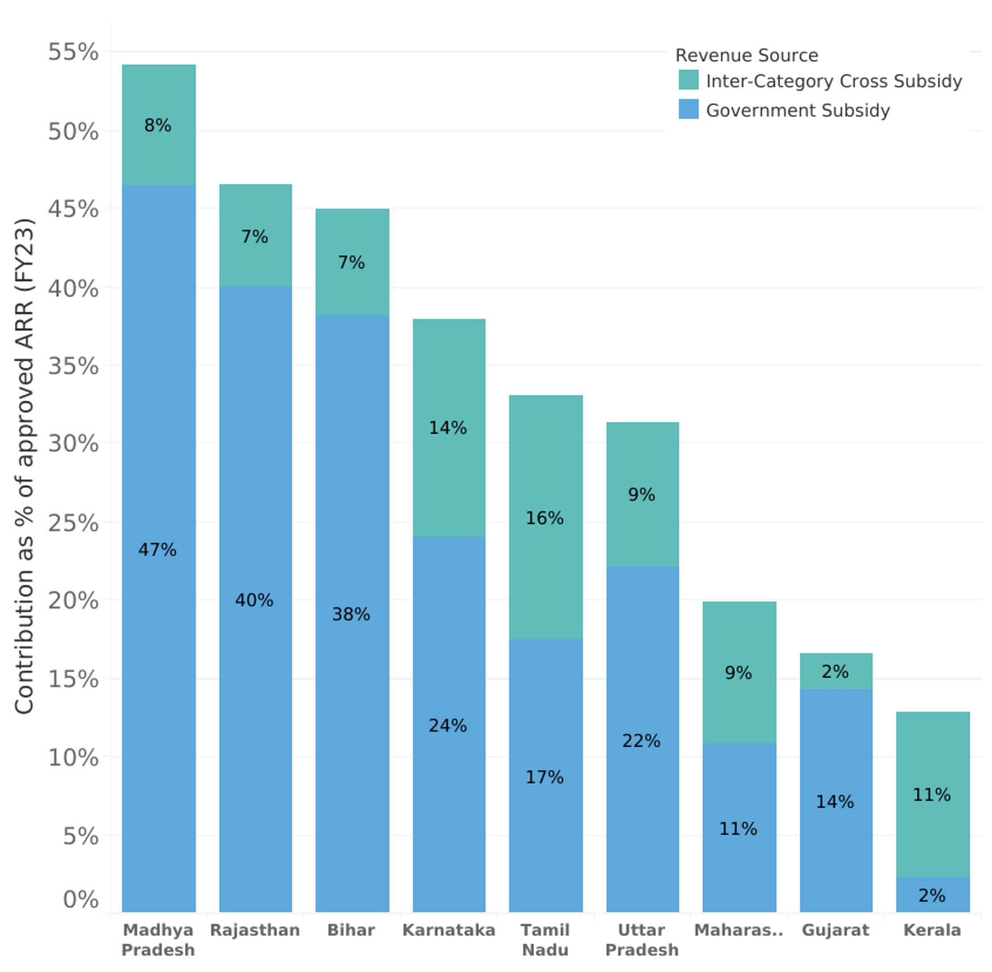
Subsidy contribution in DISCOM revenue
Reduced dependence on cross subsidy but increased dependence on subsidies
Total subsidy as approved by ERC for FY23
Dependence on Cross subsidy and Government subsidy
Revenue from subsidy ≥ 30% of the revenue requirement in six states
Madhya Pradesh, Rajasthan, Bihar, Karnataka, Tamil Nadu and Uttar Pradesh
Cross subsidy contribution to ARR ranges from 7% to 16% in 8 states
ERCs fixed tariff so cross-subsidy revenue contributes to < 10% of ARR in six states
Government subsidy contribution ranges from 11% to 47% in 8 states
>35% in Madhya Pradesh, Bihar and Rajasthan
Karnataka will see increase in FY24 with free power for domestic
Agricultural and domestic tariffs closer to average cost of supply (ACoS)
Domestic tariffs
> 90% of ACoS in 5 of 9 states, > 80% in 7 of 9 states
Agricultural tariffs
> 90% of ACoS in Madhya Pradesh and Bihar, 78% in Rajasthan.
Delhi is not included as data for FY23 was not available.

Slide 24
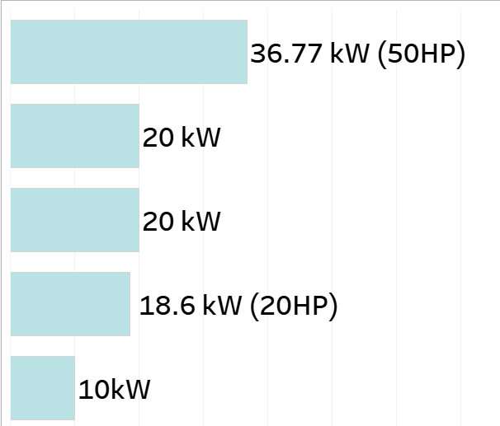
Time of Day Tariffs Levied Across the 10 States Studied
National level framework
June 2023: Electricity (Rights of Consumers) Amendment Rules, 2023 notified with framework for ToD tariffs
Applicability → Commercial and Industrial (C&I) consumers with max. demand > 10 kW , consumers with smart meters
Charges (specified as % of energy charge)
Peak penalty range → not less than 10% not more than 20% of tariff
Day time rebate → At least 20% of tariff
Slot restriction: Peak periods shall not be more than solar hours (8 hours in a day)
Applicability: Wide variation across studied states
Levy on HT consumers in 16 studied states
All states levy on HT C&I consumers but only 6 states levy on a wider ambit of HT
Only Bihar levies on all HT categories
7 states levy ToD on LT consumers
Delhi applicability for > 10 Kw for all except domestic
Three states with > 20 Kw
Applicability | States | Load above which ToD tariffs are levied
Not applicable on LT | Madhya Pradesh, Karnataka, Bihar
Some LT categories (3 or less) | Uttar Pradesh | Not specified
 | Rajasthan
 | Gujarat
 | Kerala
Most LT categories (4 or more) | Maharashtra
 | Tamil Nadu
All LT (excl. domestic) | Delhi

Slide 25
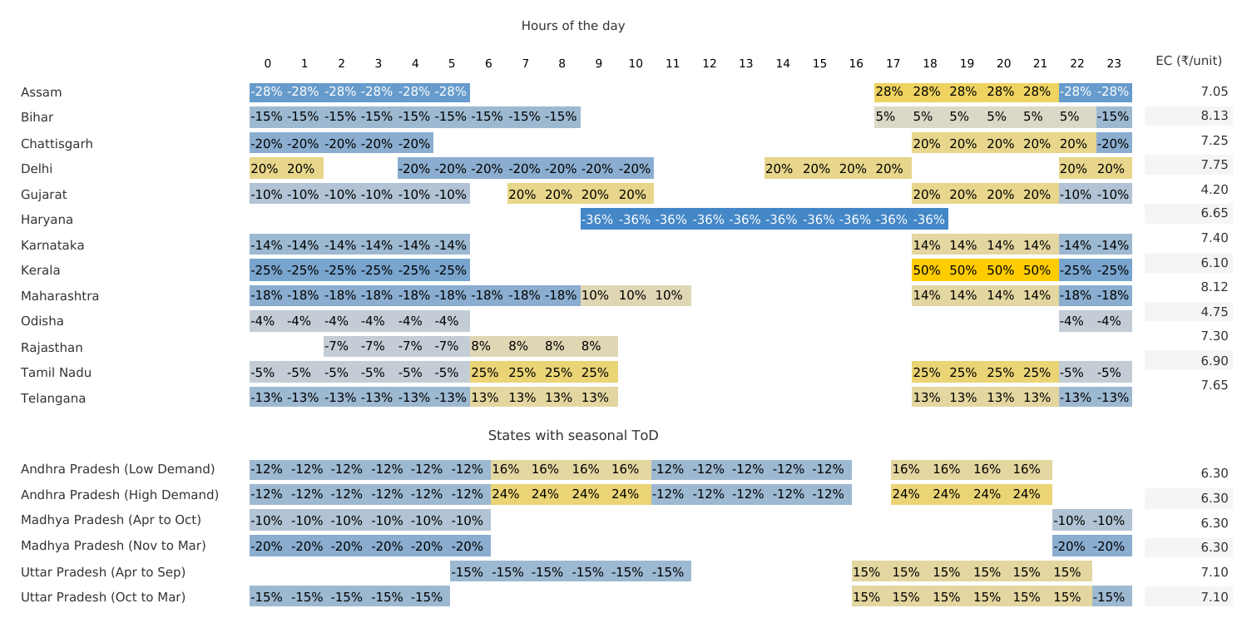
ToD Tariffs : Slots, Seasons, Extent of rebates and penalties
HT Industrial categories in 16 states for FY24
Incentives, Penalties as % of energy charges:
Haryana: 36% rebate in solar hours
Delhi: 20% penalty in solar hours.
Kerala: 50% penalty during peak and 25% rebate during off-peak
Off-peak periods in night hours, rebates range from 15% to 27%
5 states only offer rebates, no penalties
ToD tariffs vary seasonally in Andhra Pradesh, Madhya Pradesh and Uttar Pradesh
25

Slide 26
Quality of Supply and Service
DT failure rate trends

Slide 27
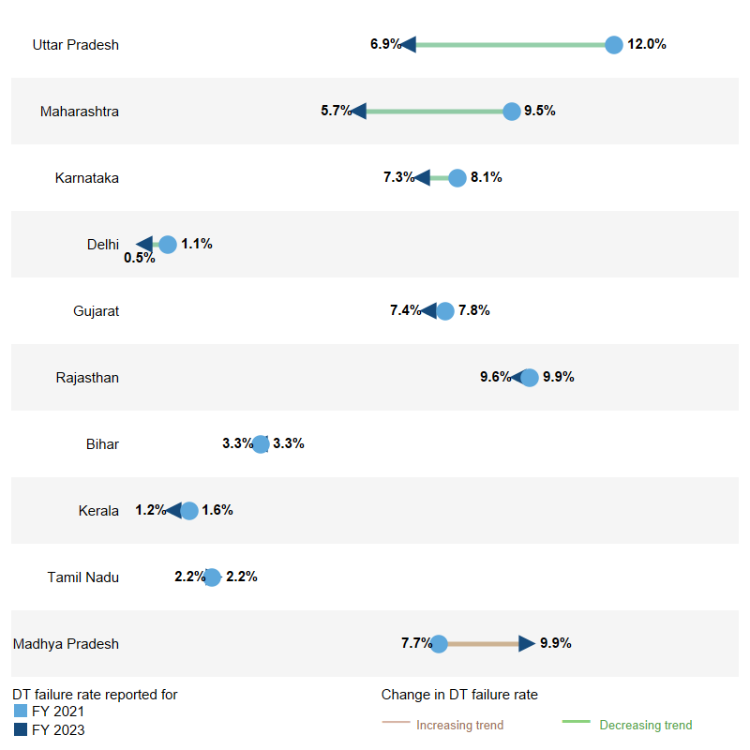
Trends in Distribution Transformer Failure rate
Good indicator of network availability, circle-wise tracking, regulatory scrutiny largely missing
Relevance
Robust and Universal Indicator of network reliability
Can help gauge network investment, O&M requirements
Ideally, time taken to repair DTs and mean time between DT failures should also be tracked.
Trends
Sharp improvement in DT failure rates reported in Uttar Pradesh and Maharashtra
Improvements also noted in Karnataka and Delhi
Marginal improvements in 5 states
Significant increase in Madhya Pradesh
Regulatory scrutiny of reporting is absent
Circle-wise DT failure rates
Wide diversity in rates across DISCOMs due to sales mix, network density and geography
Significant skewness anticipated within DISCOMs as well
Ideally DT failure rate should be tracked at circle level by national and state agencies.
27

Slide 28
Findings
- Solar feeder for Agriculture
- Measures taken towards cost compensation with sales migration
- Circle-wise Distribution Plans
- Agricultural Demand Estimation
Good Practices

Slide 29
1. Solar Feeders for Agriculture
Relevance
2 to 10 MW solar located at the feeder level
Provide day time supply to farmers |Reduce cost of supply & subsidy requirement over time| Meet DRE RPO
30% capex grant provided under MNRE’s Kusum Scheme (Component C) since 2020.
Lukewarm procurement across states in the first couple of years despite benefits due to implementation challenges
Maharashtra
Contracted 11.2 GW of capacity for feeder level agricultural solarisation.
Tariffs Rs. 2.9/ kWh and Rs. 3.3/kWh.
Largest aggregated project for decentralized solar capacity in India
80% of capacity contracted in 2024 under state scheme Mukhyamantri Saur Krushi Vahini Yojana – 2.0 (MSKVY 2.0) with KUSUM Component C support
Approach has been taken up in recent tenders of other states as well.
Gujarat
Contracted 633 MW using sub-station-wise tenders → tariff range
Rs. 2.3/kWh - Rs. 3/kWh
Madhya Pradesh
Awarded about 200 MW are tariffs between Rs. 2.3 and Rs. 3.22/unit
Key features of MSKVY 2.0
Developers:
Financial support for three years
DISCOM:
Grant for substation augmentation
Gram Panchayats:
Social benefit grant for three years
Timely payment:
Revolving fund of Rs. 700 crore for timely payments
Tendering:
Cluster based approach

Slide 30
2. Measures towards cost compensation with sales migration
Relevance
Tariffs for DISCOM services are bundled, not differentiated.
Costs for various network services are underpriced contributing to losses
Odisha: State level banking quantum limited to 400 MW/ month
Punjab: No banking during peak agricultural season
Kerala and Uttar Pradesh: Banking charges levied on net metering consumers
Maharashtra and Punjab: Monthly fixed commitment charges for standby services even if standby power is not availed.
3. Circle-wise Distribution Plans
Relevance
To support decentralised generation and address skewness in network density
Madhya Pradesh, Tamil Nadu and Andhra Pradesh
Circle-wise plans for capital investment approval to regulatory commissions
Andhra Pradesh → Plans consider load growth in each circle
4. Agricultural Demand Estimation
Relevance
Demand estimated based on a consumption norm → not revised in many states for over 10 years.
Has implications on cost, subsidy
Use of advanced metering at feeder level can improve estimation
Maharashtra
MERC estimated agricultural demand based on feeder-level input data → reduction in agricultural demand by 25%.
Led to savings of over Rs. 20,000 crores for consumers over 6 years
Not a one time exercise→ Use of monthly feeder-level input data every year
Bihar: ERC codified methodology for estimation based on feeder data in regulations

Slide 31
Findings
Areas Requiring Attention

Slide 32
Areas requiring attention
Long-term vision and medium-term planning
Utility scale demand side management
Comprehensive long-term vision with clear goals and pathways missing in the studied states.
Medium-term RE policies do not provide clear frameworks for 2030
ERCs in eight of the assessed states (exceptions are Kerala and Rajasthan), have provided a regulatory mandate for DSM
Activities towards DSM are limited.
Working capital borrowing
Responsible for majority of liabilities taken over under UDAY. Yet, there is little regulatory scrutiny/ reporting.
Three states report actual working capital borrowing to ERCs
Wide variation in practices in capturing data in financial audit reports.
Supply and service quality
Integrated Resource Planning
─ IRP not conducted in states. Only Bihar has regulatory mandate which is not exercised.
─ States have been notifying Resource Adequacy regulations (Madhya Pradesh, Meghalaya), drafts in Punjab, Maharashtra, Arunachal Pradesh
Only four of ten states published quarterly reports on Standards of Performance (SoP) in the year FY24
No SoP reports for years in 5 states
Regulatory oversight has been limited.

Slide 33
Lessons and Insights

Slide 34
Lessons and Insights
Substantial activity in recent years towards meeting energy transition goals at the state level
Developments in RE procurement, storage deployment and green energy open access in a relatively short period.
Scaling of solar feeder for agriculture in Maharashtra, record low tariffs for stand alone storage in Gujarat
Many developments are driven by Central Sector frameworks and policies
Green Open Access – reduction in limit for open access from 1 MW to 100 kW in 14 states
Group Net Metering – Only 2 states had enabling frameworks before MNRE framework and direction
Implementation of Late Payment Surcharge Rules has halved the pending dues to generators in 2 years
Implementing frameworks would require investment and efforts at the state-level with central sector support
Resource Adequacy frameworks requires support when states have not been undertaking periodic long term-demand supply assessments.
Similarly, clear frameworks for RPO compliance and targets across states

Slide 35
Lessons and Insights
Articulation of long-term objectives and pathways by states can accelerate pace of ongoing developments
Can enable coordinated efforts and reduce the risk of ad-hoc, issue-based responses, provide investor certainty and even inform national frameworks
This is currently missing in states but should evolve in the near future
Regulators will play a crucial role in the unfolding complex transition, their mandate needs to be expanded and effectively exercised
Regulatory action key to many ongoing developments and innovations → Reduction in cross-subsidy revenue across states, Circle wise network planning in three states, addressing implementation challenges related to green open access, agricultural demand estimation in Maharashtra, Punjab and Haryana
Timely regulatory action required to provide clarity → 11 of 16 states have not revised the grid code since 2015, DT capacity limit for net metering at 100% only in Gujarat and at 75% to 80% in most states, 30% in Rajasthan.
Regulators can increase accountability and attention on crucial areas that do not get enough attention→ Demand Side Management, Quality of Supply and Service etc.

Slide 36
Coordinated efforts are needed on multiple fronts to accelerate the pace of the transition.
Several good practices and innovations in various states need to be further shared and replicated.
Greater alignment of central and state policy frameworks and actions will enable a transition that is not only dominated by techno-economic changes but also reflects the development needs of the country.
To learn more, please visit etpi.in

